Slide 1

Covid-19 detection using chest x-ray with CNN
By- Abhinav Bahuguna Sec/Roll No.- A/01
Student ID- 20011541 Sem- 6th

Slide 2
The primary objective of the project was to create A COVID-19 detection system that can assist healthcare professionals in swiftly identifying +ve/-ve cases through the analysis of chest x-ray images.
OBJECTIVE

Slide 3
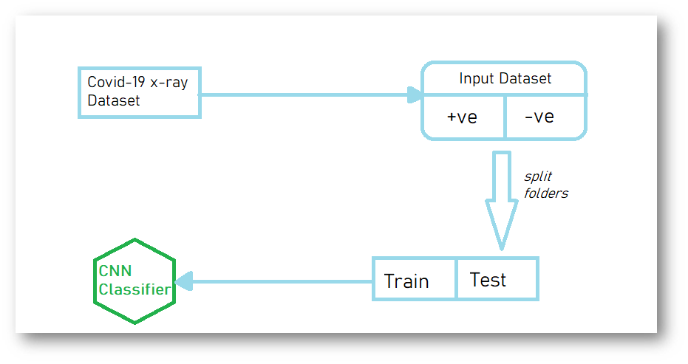
OVERVIEW

Slide 4
- Python (ver. 3.10.4), flask (2.3.2) - Tensorflow (2.10.1), keras, numpy, pandas, matplotlib, etc. - Jupyter notebook (for model training) - Dataset: https://www.kaggle.com/datasets/mr3suvhro/covid-19-xray-image-dataset-with-huge-samples?select=COVID
Requirements:-

Slide 5
Thank You!

